Slide 1
Data Communication and Networking (DCAN 202)
Week 6

Slide 2
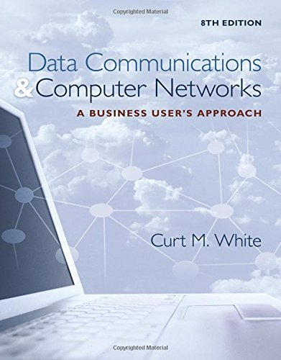
Chapter 9: Introduction to Metropolitan Area Networks and Wide Area Networks
Data Communications and Computer Networks: A Business User's Approach, Eighth Edition
© 2016. Cengage Learning. All right reserved.

Slide 3
Todays Lecture
Distinguish local area networks, metropolitan area networks, and wide area networks from each other
Characteristics of metropolitan area networks and compare to LANs and WANs
Describe how circuit-switched, datagram packet-switched, and virtual circuit packet-switched networks work
Differences between connection-oriented and connectionless networks
Data Communications and Computer Networks: A Business User's Approach, Eighth Edition
© 2016. Cengage Learning. All Rights Reserved.

Slide 4
Todays Lecture
Differences between centralized and distributed routing
Differences between static and adaptive routing
Characteristics of flooding,
use hop count and hop limit in a simple example
Concepts of network congestion & quality of service
Data Communications and Computer Networks: A Business User's Approach, Eighth Edition
© 2016. Cengage Learning. All Rights Reserved.

Slide 5
Introduction
As we have seen, a local area network covers a room, a building or a campus.
A metropolitan area network (MAN) covers a city or a region of a city.
A wide area network (WAN) covers multiple cities, states, countries, and even the solar system.
Data Communications and Computer Networks: A Business User's Approach, Eighth Edition
© 2016. Cengage Learning. All Rights Reserved.

Slide 6
Metropolitan Area Network Basics
MANs borrow technologies from LANs and WANs.
MANs support high-speed disaster recovery systems, real-time transaction backup systems, interconnections between corporate data centers and Internet service providers, and government, business, medicine, and education high-speed interconnections.
Almost exclusively fiber optic systems
Data Communications and Computer Networks: A Business User's Approach, Eighth Edition
© 2016. Cengage Learning. All Rights Reserved.

Slide 7
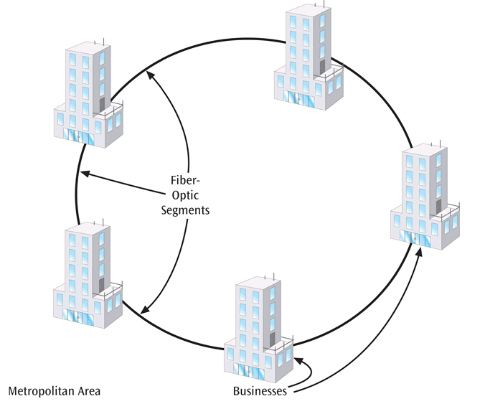
Metropolitan Area Network Basics
MANs have very high transfer speeds
MANs can recover from network faults very quickly (failover time)
MANs are very often a ring topology (not a star-wired ring)
Some MANs can be provisioned dynamically
A Physical ring used to support a MAN
Data Communications and Computer Networks: A Business User's Approach, Eighth Edition
© 2016. Cengage Learning. All Rights Reserved.

Slide 8
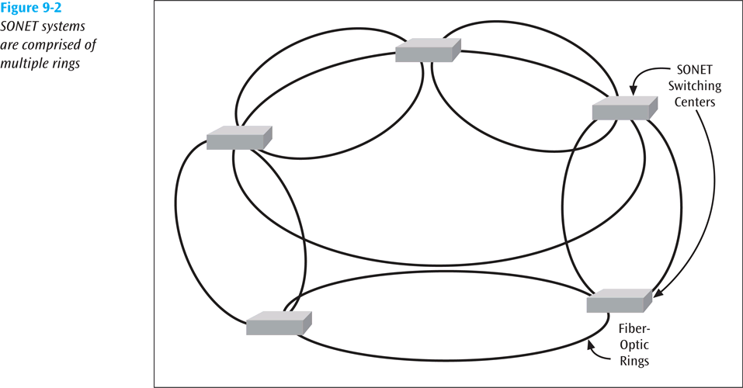
SONET versus Ethernet MANs
Most MANs are SONET network built of multiple rings (for failover purposes)
SONET is well-proven but complex, fairly expensive, and cannot be provisioned dynamically.
SONET is based upon T-1 rates and does not fit nicely into 1 Mbps, 10 Mbps, 100 Mbps, 1000 Mbps chunks, like Ethernet systems do.
Ethernet MANs generally have high failover times
SONET systems are comprised of multiple rings
Data Communications and Computer Networks: A Business User's Approach, Eighth Edition
© 2016. Cengage Learning. All Rights Reserved.

Slide 9
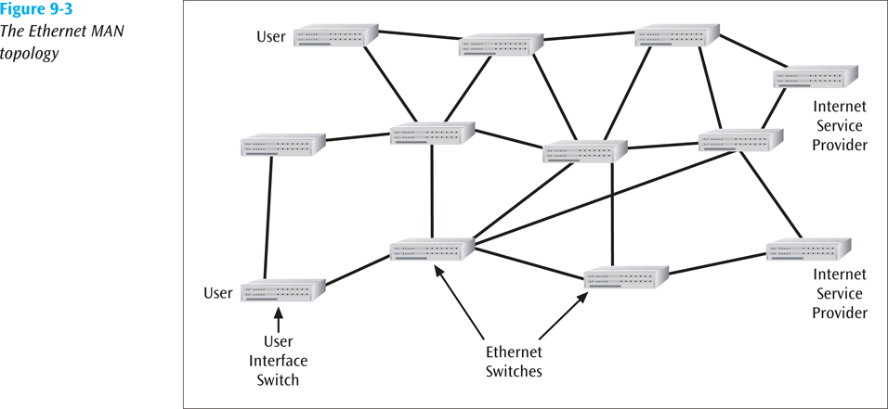
SONET versus Ethernet MANs
The Ethernet MAN topology
Data Communications and Computer Networks: A Business User's Approach, Eighth Edition
© 2016. Cengage Learning. All Rights Reserved.

Slide 10
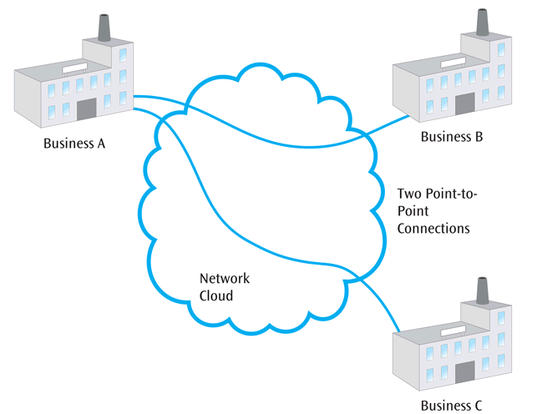
Metro Ethernet
One of the latest forms of the metropolitan area network is metro Ethernet
Metro Ethernet is a service in which the provider creates a door-to-door Ethernet connection between two locations
For example, you may connect your business with a second business using a point-to-point Ethernet connection -> See Figure
Two point-to-point connections
Data Communications and Computer Networks: A Business User's Approach, Eighth Edition
© 2016. Cengage Learning. All Rights Reserved.

Slide 11
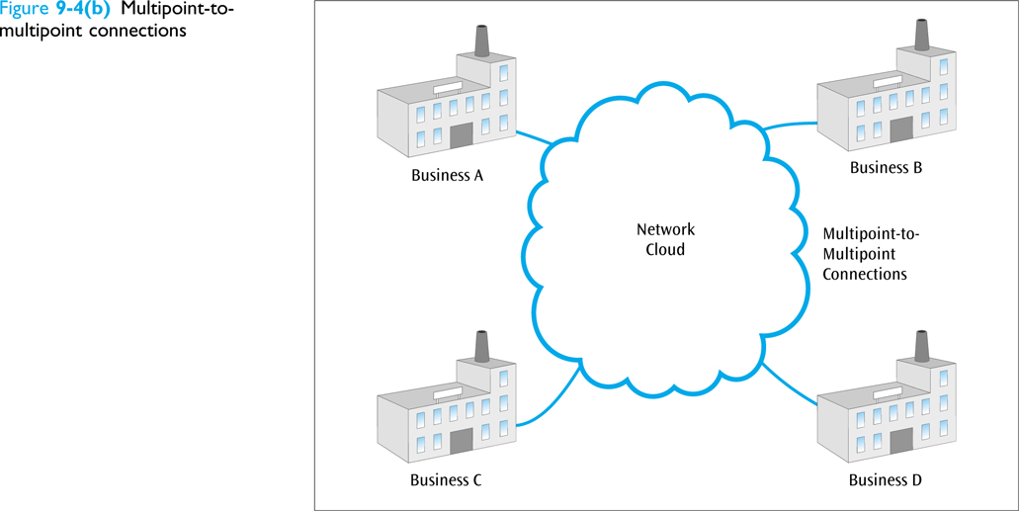
Metro Ethernet
You may also connect your business with multiple businesses using a connection similar to a large local area network.
Thus, by simply sending out one packet, multiple companies may receive the data
Neat thing about metro Ethernet is the way it seamlessly connects with a company’s internal Ethernet network(s)
Multipoint-to-multipoint connections
Data Communications and Computer Networks: A Business User's Approach, Eighth Edition
© 2016. Cengage Learning. All Rights Reserved.

Slide 12
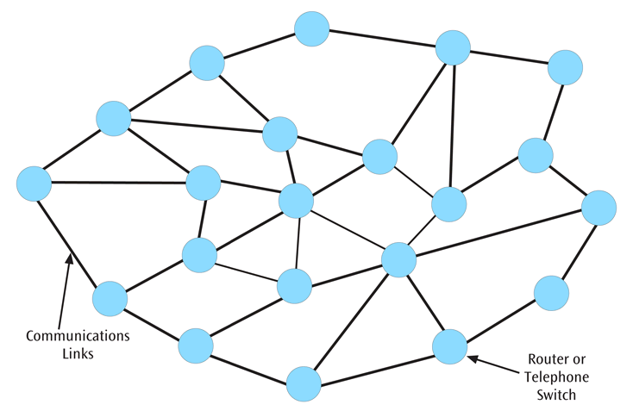
Wide Area Network Basics
WANs used to be characterized with slow, noisy lines.
Today WANs are very high speed with very low error rates.
WANs usually follow a mesh topology.
A simple mesh network
Data Communications and Computer Networks: A Business User's Approach, Eighth Edition
© 2016. Cengage Learning. All Rights Reserved.

Slide 13
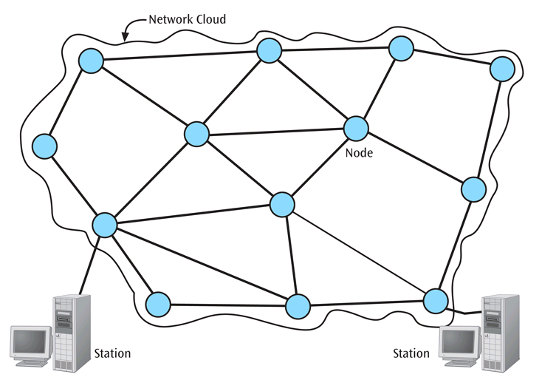
Wide Area Network Basics
A station is a device that interfaces a user to a network.
A node is a device that allows one or more stations to access the physical network and is a transfer point for passing information through a network.
A node is often a computer, a router, or a telephone switch.
The sub-network or physical network is the underlying connection of nodes and telecommunication links.
Network cloud, nodes and two end stations
Data Communications and Computer Networks: A Business User's Approach, Eighth Edition
© 2016. Cengage Learning. All Rights Reserved.

Slide 14
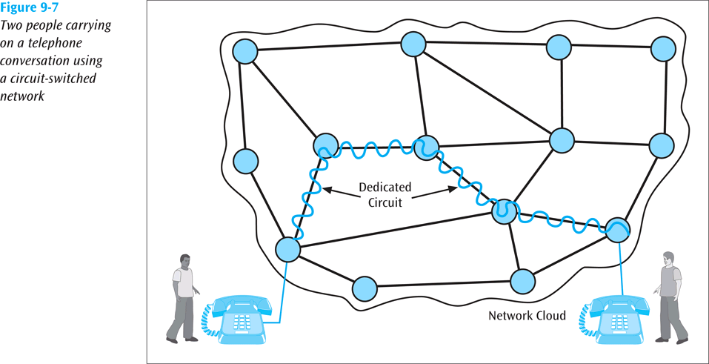
Types of Network Structures
Circuit switched network - a sub-network in which a dedicated circuit is established between sender and receiver and all data passes over this circuit.
The telephone system is a common example.
The connection is dedicated until one party or another terminates the connection.
AT&T announced end of 2009 that they will begin phasing out their switched networks
Circuit switched network example
Data Communications and Computer Networks: A Business User's Approach, Eighth Edition
© 2016. Cengage Learning. All Rights Reserved.

Slide 15
Types of Network Structures
Packet switched network - a network in which all data messages are transmitted using fixed-sized packages, called packets.
More efficient use of a telecommunications line since packets from multiple sources can share the medium.
One form of packet switched network is the datagram. With a datagram, each packet is on its own and may follow its own path.
Virtual circuit packet switched network create a logical path through the subnet and all packets from one connection follow this path.
Data Communications and Computer Networks: A Business User's Approach, Eighth Edition
© 2016. Cengage Learning. All Rights Reserved.

Slide 16
Types of Network Structures
Broadcast network - a network typically found in local area networks but occasionally found in wide area networks.
A workstation transmits its data and all other workstations “connected” to the network hear the data. Only the workstation(s) with the proper address will accept the data.
Data Communications and Computer Networks: A Business User's Approach, Eighth Edition
© 2016. Cengage Learning. All Rights Reserved.

Slide 17
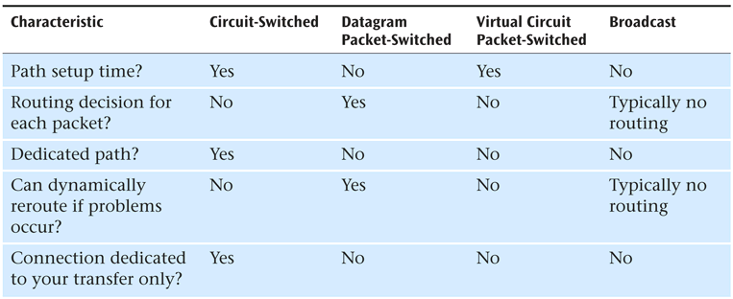
Summary of Network Structures
Network cloud characteristics
Table: Summary of network cloud characteristics
Data Communications and Computer Networks: A Business User's Approach, Eighth Edition
© 2016. Cengage Learning. All Rights Reserved.

Slide 18
Connection-oriented versus Connectionless
The network structure is the underlying physical component of a network. What about the software or application that uses the network?
A network application can be either connection-oriented or connectionless.
Data Communications and Computer Networks: A Business User's Approach, Eighth Edition
© 2016. Cengage Learning. All Rights Reserved.

Slide 19
Connection-oriented versus Connectionless
A connection-oriented application requires both sender and receiver to create a connection before any data is transferred.
Applications such as large file transfers and sensitive transactions such as banking and business are typically connection-oriented.
A connectionless application does not create a connection first but simply sends the data. Electronic mail is a common example.
Data Communications and Computer Networks: A Business User's Approach, Eighth Edition
© 2016. Cengage Learning. All Rights Reserved.

Slide 20
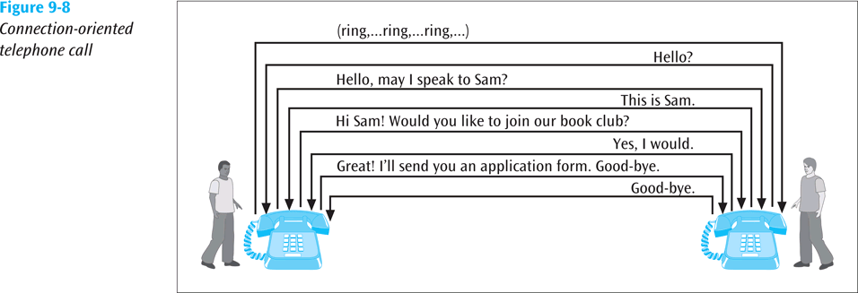
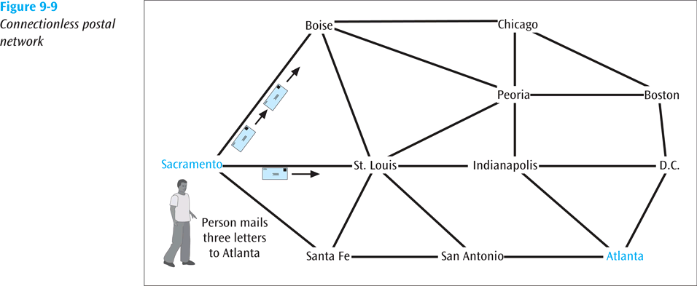
Connection-oriented versus Connectionless
Connection-oriented telephone call
Connectionless postal network
Data Communications and Computer Networks: A Business User's Approach, Eighth Edition
© 2016. Cengage Learning. All Rights Reserved.

Slide 21
Connection-oriented versus Connectionless
A connection-oriented application can operate over both a circuit switched network or a packet switched network.
A connectionless application can also operate over both a circuit switched network or a packet switched network but a packet switched network may be more efficient.
Data Communications and Computer Networks: A Business User's Approach, Eighth Edition
© 2016. Cengage Learning. All Rights Reserved.

Slide 22
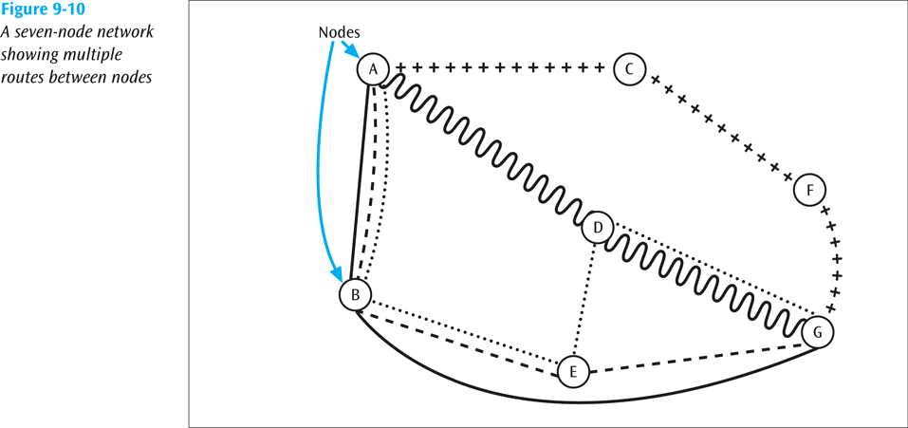
Routing
Each node in a WAN is a router that accepts an input packet, examines the destination address, and forwards the packet on to a particular telecommunications line.
How does a router decide which line to transmit on?
A router must select the one transmission line that will best provide a path to the destination and in an optimal manner.
Often many possible routes exist between sender and receiver.
A seven-node network showing multiple routes between nodes
Data Communications and Computer Networks: A Business User's Approach, Eighth Edition
© 2016. Cengage Learning. All Rights Reserved.

Slide 23
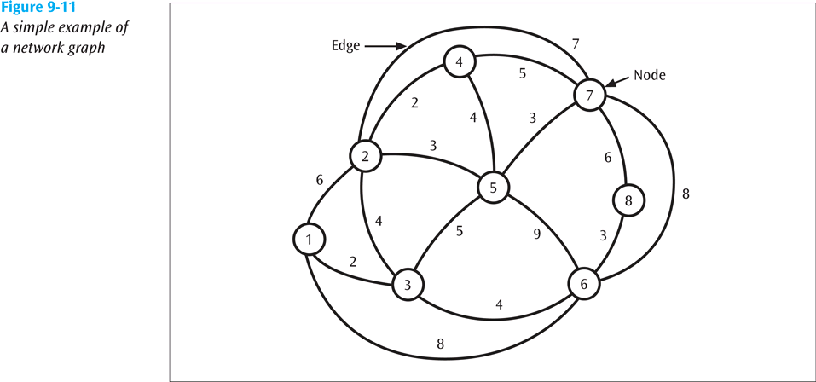
Routing
The communications network with its nodes and telecommunication links is essentially a weighted network graph.
The edges, or telecommunication links, between nodes, have a cost associated with them.
The cost could be a delay cost, a queue size cost, a limiting speed, or simply a dollar amount for using that link.
A simple example of a network graph
Data Communications and Computer Networks: A Business User's Approach, Eighth Edition
© 2016. Cengage Learning. All Rights Reserved.

Slide 24
Routing
The routing method, or algorithm, chosen to move packets through a network should be:
Optimal, so the least cost can be found
Fair, so all packets are treated equally
Robust, in case link or node failures occur and the network has to reroute traffic.
Not too robust so that the chosen paths do not oscillate too quickly between troubled spots.
Data Communications and Computer Networks: A Business User's Approach, Eighth Edition
© 2016. Cengage Learning. All Rights Reserved.

Slide 25
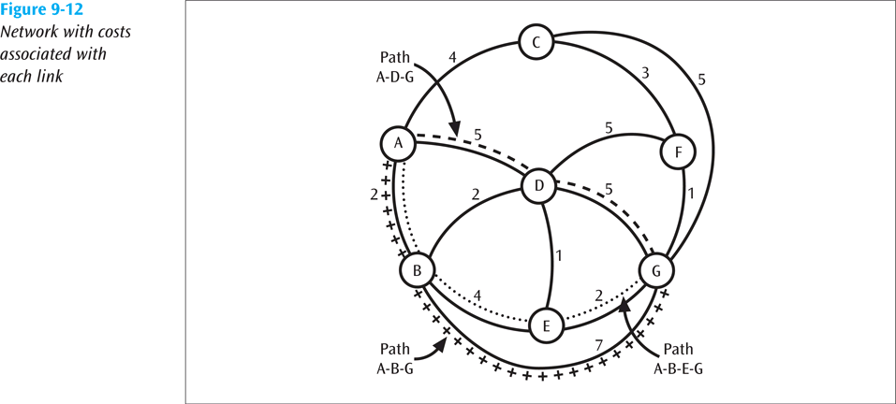
Least Cost Routing Algorithm
Dijkstra’s least cost algorithm finds all possible paths between two locations.
By identifying all possible paths, it also identifies the least cost path.
The algorithm can be applied to determine the least cost path between any pair of nodes.
Network with costs associated with each link
Data Communications and Computer Networks: A Business User's Approach, Eighth Edition
© 2016. Cengage Learning. All Rights Reserved.

Slide 26
Flooding Routing
When a packet arrives at a node, the node sends a copy of the packet out every link except the link the packet arrived on.
Traffic grows very quickly when every node floods the packet.
To limit uncontrolled growth, each packet has a hop count. Every time a packet hops, its hop count is incremented. When a packet’s hop count equals a global hop limit, the packet is discarded.
Data Communications and Computer Networks: A Business User's Approach, Eighth Edition
© 2016. Cengage Learning. All Rights Reserved.

Slide 27
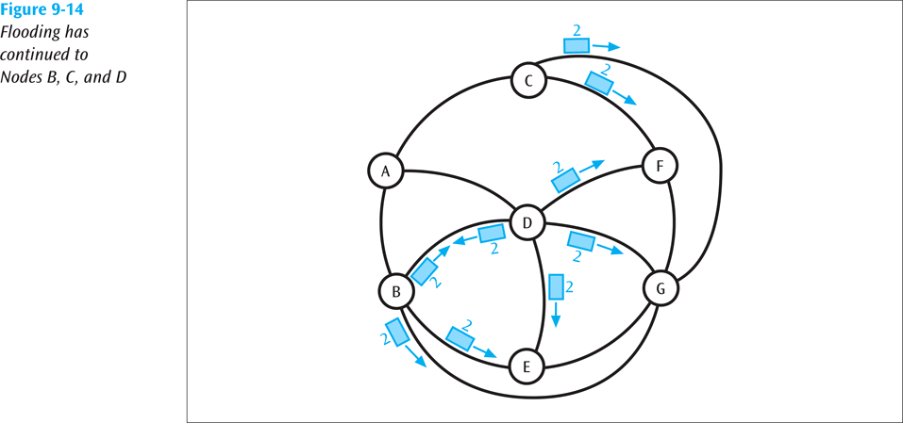
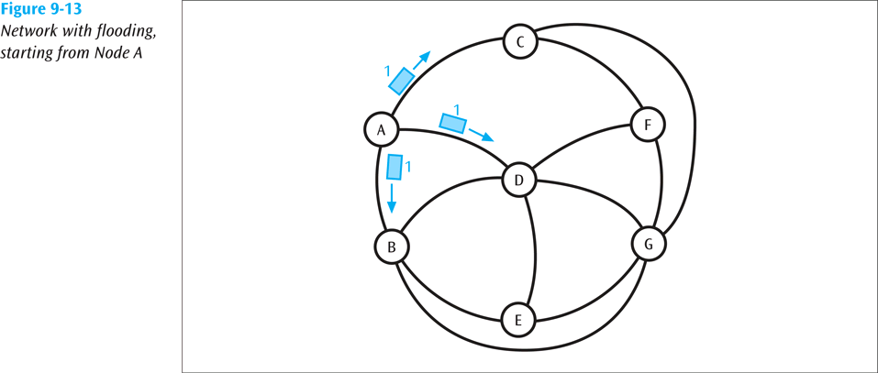
Flooding Routing
Network with flooding, starting from Node A
Flooding has continued to Nodes B,C, and D
Data Communications and Computer Networks: A Business User's Approach, Eighth Edition
© 2016. Cengage Learning. All Rights Reserved.

Slide 28
Centralized Routing
One routing table is kept at a “central” node.
Whenever a node needs a routing decision, the central node is consulted.
To survive central node failure, the routing table should be kept at a backup location.
The central node should be designed to support a high amount of traffic consisting of routing requests.
Data Communications and Computer Networks: A Business User's Approach, Eighth Edition
© 2016. Cengage Learning. All Rights Reserved.

Slide 29
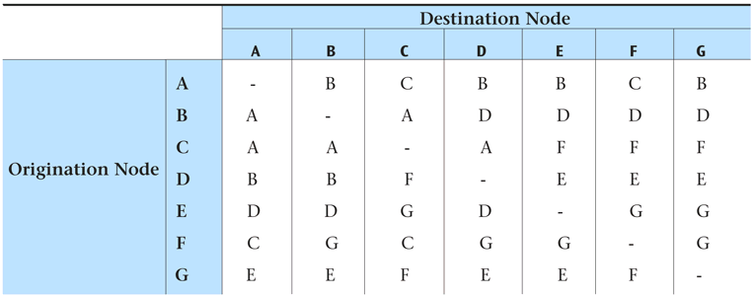
Centralized Routing
Centralized Routing
Table: Routing table kept at a centralised network site
Data Communications and Computer Networks: A Business User's Approach, Eighth Edition
© 2016. Cengage Learning. All Rights Reserved.

Slide 30
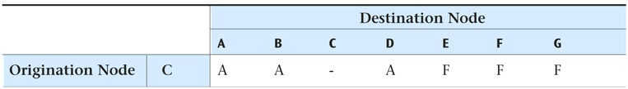
Distributed Routing
Each node maintains its own routing table.
No central site holds a global table.
Somehow each node has to share information with other nodes so that the individual routing tables can be created.
Possible problem with individual routing tables holding inaccurate information.
Table: Local routing table for Node C
Data Communications and Computer Networks: A Business User's Approach, Eighth Edition
© 2016. Cengage Learning. All Rights Reserved.

Slide 31
Adaptive Routing versus Static Routing
With adaptive routing, routing tables can change to reflect changes in the network
Static routing does not allow the routing tables to change.
Static routing is simpler but does not adapt to network congestion or failures.
Data Communications and Computer Networks: A Business User's Approach, Eighth Edition
© 2016. Cengage Learning. All Rights Reserved.

Slide 32
Routing Examples - RIP
Routing Information Protocol (RIP) - First routing protocol used on the Internet.
A form of distance vector routing. It was adaptive and distributed
Each node kept its own table and exchanged routing information with its neighbors.
Data Communications and Computer Networks: A Business User's Approach, Eighth Edition
© 2016. Cengage Learning. All Rights Reserved.

Slide 33
Routing Examples - RIP
Suppose that Router A has connections to four networks (123, 234, 345, and 789) and has the following current routing table:
Network Hop Cost Next Router
123 8 B
234 5 C
345 6 C
789 10 D
Data Communications and Computer Networks: A Business User's Approach, Eighth Edition
© 2016. Cengage Learning. All Rights Reserved.

Slide 34
Routing Examples - RIP
Now suppose Router D sends out the following routing information (note that Router D did not send Next Router information, since each router will determine that information for itself):
Network Hop Cost
123 4
345 5
567 7
789 10
Data Communications and Computer Networks: A Business User's Approach, Eighth Edition
© 2016. Cengage Learning. All Rights Reserved.

Slide 35
Routing Examples - RIP
Router A will look at each entry in Router D’s table and make the following decisions:
1. Router D says Network 123 is 4 hops away (from Router D). Since Router D is 1 hop away from Router A, Network 123 is actually 5 hops away from Router A. That is better than the current entry of 8 hops in Router A’s table, so Router A will update the entry for Network 123.
2. Router D says Network 345 is 5 hops away. Add one hop to get to Router D and Network 345 is 6 hops away. That is currently the same hop count as shown in Router A’s table for Network 345, so Router A will not update its table.
Data Communications and Computer Networks: A Business User's Approach, Eighth Edition
© 2016. Cengage Learning. All Rights Reserved.

Slide 36
Routing Examples - RIP
Router A will look at each entry in Router D’s table and make the following decisions:
3. Router D says Network 567 is 7 hops away. Add 1 hop to get to Router D, giving 8 hops. Since Router A has no information about Network 567, Router A will add this entry to its table. And since the information is coming from Router D, Router A’s Next Router entry for network 567 is set to D.
4. Router D says Network 789 is 10 hops away. Add 1 hop to get to Router D. The value of 11 hops is worse than the value currently in Router A’s table. Since Router A currently has information from Router D, and Router D is now saying it takes more hops to get to Network 789, then Router A has to use this information.
Data Communications and Computer Networks: A Business User's Approach, Eighth Edition
© 2016. Cengage Learning. All Rights Reserved.

Slide 37
Routing Examples - RIP
Router A’s updated routing table will thus look like the following:
Network Hop Cost Next Router
123 5 D
234 5 C
345 6 C
567 8 D
789 11 D
Data Communications and Computer Networks: A Business User's Approach, Eighth Edition
© 2016. Cengage Learning. All Rights Reserved.

Slide 38
Routing Examples - OSPF
Open Shortest Path First (OSPF) - Second routing protocol used on the Internet
A form of link state routing
It too was adaptive and distributed but more complicated than RIP and performed much better
Data Communications and Computer Networks: A Business User's Approach, Eighth Edition
© 2016. Cengage Learning. All Rights Reserved.

Slide 39
Network Congestion
When a network or a part of a network becomes so saturated with data packets that packet transfer is noticeably impeded, network congestion occurs.
What can cause network congestion? Node and link failures; high amounts of traffic; improper network planning.
When serious congestion occurs buffers overflow and packets are lost.
Data Communications and Computer Networks: A Business User's Approach, Eighth Edition
© 2016. Cengage Learning. All Rights Reserved.

Slide 40
Network Congestion
What can we do to reduce or eliminate network congestion?
An application can observe its own traffic and notice if packets are disappearing. If so, there may be congestion. This is called implicit congestion control.
The network can inform its applications that congestion has occurred and the applications can take action. This is called explicit congestion control.
Data Communications and Computer Networks: A Business User's Approach, Eighth Edition
© 2016. Cengage Learning. All Rights Reserved.

Slide 41
Congestion Avoidance
Before making a connection, user requests how much bandwidth is needed, or if connection needs to be real-time
Network checks to see if it can satisfy user request
If user request can be satisfied, connection is established
If a user does not need a high bandwidth or real-time, a simpler, cheaper connection is created
This is often called connection admission control
Asynchronous transfer mode is a very good example of this (Chapter Eleven)
Data Communications and Computer Networks: A Business User's Approach, Eighth Edition
© 2016. Cengage Learning. All Rights Reserved.

Slide 42
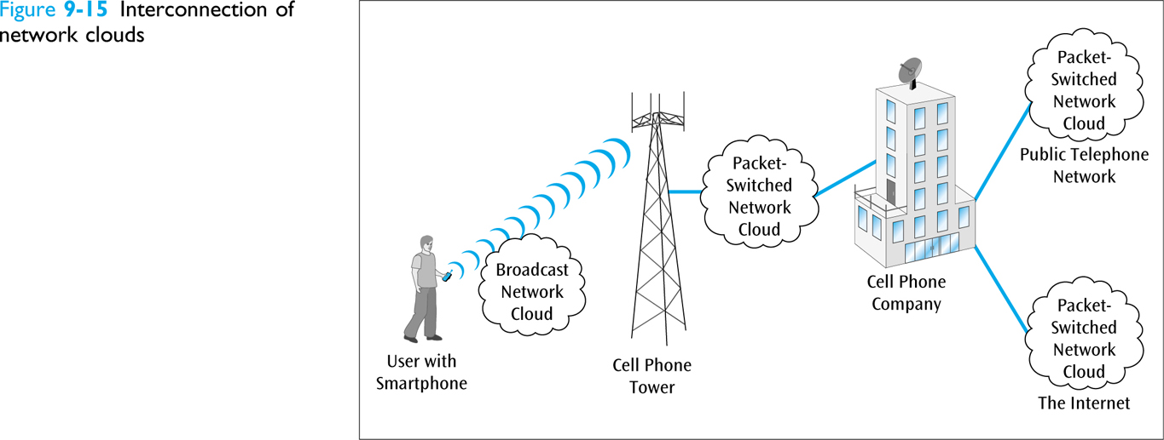
WANs In Action: The Smartphone
The network structure that support cell phones and smartphones is growing more complex every day
All phones within transmission distance of a cell tower are participating in a broadcast network
Interconnection of network clouds
Data Communications and Computer Networks: A Business User's Approach, Eighth Edition
© 2016. Cengage Learning. All Rights Reserved.

Slide 43
WANs In Action: The Smartphone
Once your data/signal reaches the cell tower, the data becomes part of a packet-switched network within the telephone company
If the data moves from the telephone company into the Internet, then your data is passed from one packet switched network to another
Data Communications and Computer Networks: A Business User's Approach, Eighth Edition
© 2016. Cengage Learning. All Rights Reserved.

Slide 44
Summary
A metropolitan area network is fast, fiber-based, has very small failover times, and is often dynamically provisional
Early MANs were SONET-based, but Ethernet-based MANs are becoming very popular
SONET-based MANs are rings, while Ethernet-based MANs are meshes
Metro Ethernet is a popular form of MAN
Data Communications and Computer Networks: A Business User's Approach, Eighth Edition
© 2016. Cengage Learning. All Rights Reserved.

Slide 45
Summary (continued)
Wide area networks cover states, countries, the world
User connects to a station and the station interfaces to a network node
A WAN cloud is based upon nodes (routers/switches) and high-speed links
WANs can be circuit-switched (fading away) or packet switched (datagram and virtual circuit)
RIP and OSPF are two routing protocols
Data Communications and Computer Networks: A Business User's Approach, Eighth Edition
© 2016. Cengage Learning. All Rights Reserved.

